Slide 1

Airfly insights : data visualization and analysis of airline operation
Interactive Data Visualization of Global Travel and Holidays
Mentor Name:

Slide 2
WorldVoyage: Global Holidays and Travel Data
Airfly insights : data visualization and analysis of airline operation
Mentor Name: swaraj aalla

Slide 3


Introduction
This project analyzes large-scale airline flight data to uncover key patterns in operations, delays, cancellations, and travel behavior.
The analysis highlights major routes, seasonal travel trends, delay causes, and cancellation patterns.
Clear charts, maps, and KPIs make complex information easy to explore and understand.
The goal is to support airlines, airports, and decision-makers with actionable insights that improve operational planning, reduce delays, and enhance passenger experience.

Slide 4
Dataset Overview
The airline delay dataset was analyzed to study flight trends, delay behavior, and performance metrics.
The initial dataset contained 484,551 rows and 29 columns.
After data cleaning and feature engineering, the dataset was reduced to 484,549 rows.
New attributes were added, increasing the total to 33 columns in the processed dataset.
Overall, the dataset comprises 14,051,979 total data points, enabling detailed analysis.

Slide 5

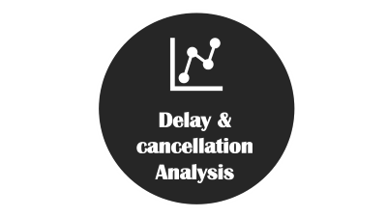

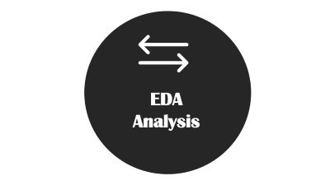
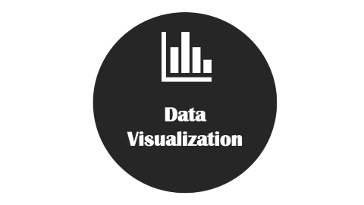

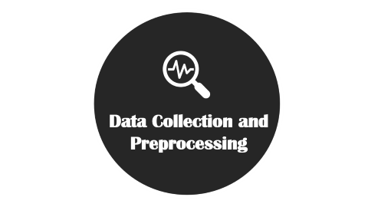




TECHNOLOGY STACK

Slide 6

Data Cleaning and Preprocessing

Slide 7

Data Cleaning and Preprocessing
1. Data Cleaning
Removed missing, duplicate, and inconsistent flight records.
Standardized date/time formats (DepTime, ArrTime, FlightDate).
Fixed incorrect or negative delay values using logical rules.
2. Data Transformation
Converted data types (integer, float, datetime) to ensure accuracy.
Normalized columns like Airline, Origin, Destination for uniform formatting.
Extracted new fields from timestamps (Year, Month, Day, Hour)
3. Feature Engineering
Created Route = Origin → Destination.
Added MonthName & MonthNum for sorting and seasonal patterns.
Derived TotalDelay, DelayFlag, and CancellationReason fields.
4. Data Reduction & Optimization
Removed irrelevant columns to improve performance.
Downcast numerical data to reduce memory usage.
Filtered dataset to include only meaningful flight records.

Slide 8

EDA
Analysis

Slide 9

EDA Analysis
Univariate Analysis
Analyzed the distribution of delays, cancellation counts, flight timings, and monthly travel patterns.
Identified right-skewed delay distributions with a few extreme outliers.
Found the busiest months, days, and airlines based on overall flight frequency.
Bivariate / Multivariate Analysis
Compared delays across airlines, routes, and airports to identify high-delay segments.
Used correlation heatmaps to study relationships between delay variables.
Found a strong correlation between Departure Delay and Arrival Delay, indicating dependency.

Slide 10

Data
Visualization

Slide 11

Data Visualization
Created multiple visualizations including bar charts, line charts, heatmaps, pie/donut charts, count plots, histograms, and boxplots to explore flight trends, delays, cancellations, and route performance.
These visualizations helped identify busiest airlines, top routes, and peak travel months, along with seasonal delay patterns across the dataset.
Correlation heatmaps revealed a strong relationship between departure and arrival delays, while pie charts highlighted weather and NAS-related cancellations.
Distribution and boxplot analyses uncovered delay frequency, outliers, and airline-wise delay variability, providing deeper insights into route-specific and seasonal behavior.

Slide 12

Delay & cancellation Analysis

Slide 13

Delay & Cancellation Analysis
1. Delay Analysis
Analyzed Departure Delay and Arrival Delay across airlines, routes, and airports.
Found that delays show a right-skewed pattern, with most flights experiencing minor delays and a few extreme outliers.
Identified peak delay hours during morning and evening flight windows.
Seasonal analysis revealed higher delays during winter and holiday months.
Strong correlation observed between DepDelay and ArrDelay, indicating that early delays propagate throughout the route.
2. Cancellation Analysis
Examined overall cancellations and categorized them by reason: Carrier, Weather, NAS (Air Traffic Control), and Security.
Weather-related cancellations showed clear seasonal spikes (winter, storms).
Carrier-related cancellations were more consistent across the year.
Route-level analysis highlighted airports with higher cancellation probabilities due to operational and environmental factors.

Slide 14

PowerBI
Dashboard

Slide 15
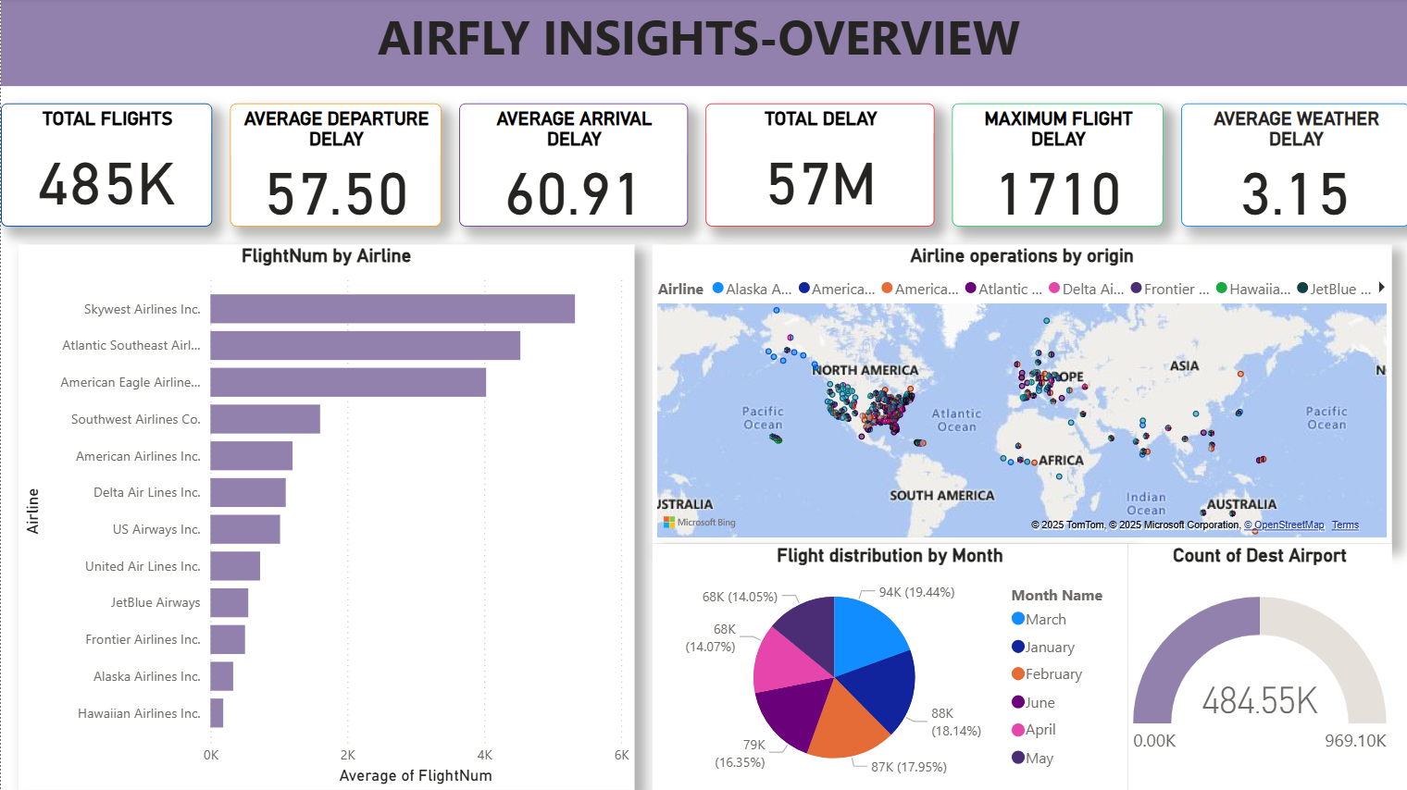

Slide 16
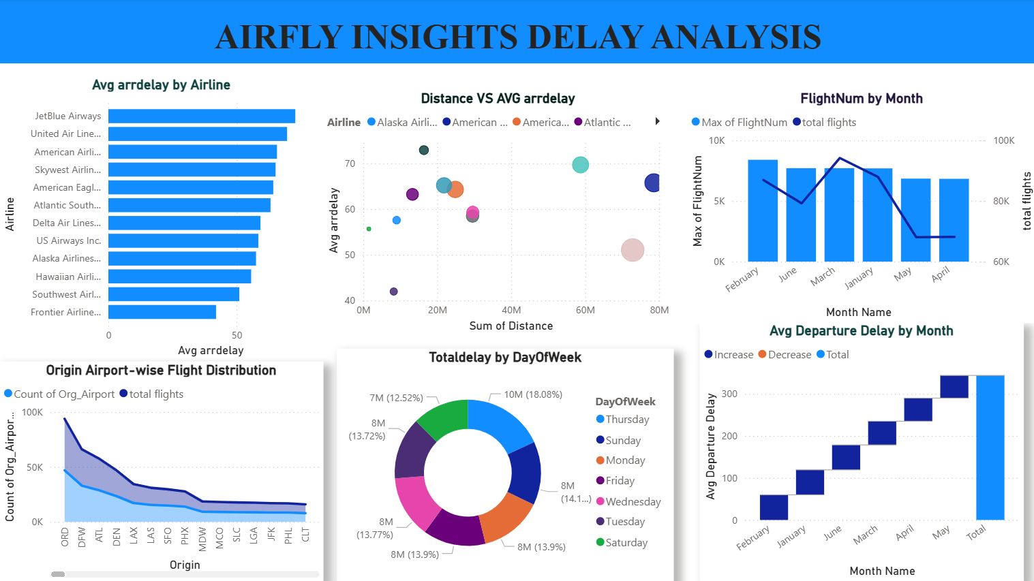

Slide 17






CHALLENGES
Handling Missing & Inconsistent Data
Complex Time Conversion
Large Dataset Processing
Feature Engineering Difficulty
Designing Accurate Visuals
Identifying Patterns Across Seasons & Routes

Slide 18

FUTURE ENHANCEMENTS

Slide 19





Real-Time Integration
Predictive Modeling
Route
Optimization
Passenger Insights
Cloud Deployment

Slide 20



CONCLUSION
Successful Project Execution
The project effectively covered the entire data analytics lifecycle, including data collection, cleaning, transformation, visualization, and deployment, achieving the set objectives.
Insightful Dashboard Development
The Power BI dashboards offered clear insights into flight operations, delays, cancellations, and route performance, making complex airline data easy to interpret and analyze.
Real-World Impact
The solution provides valuable insights for airlines, airports, and aviation authorities, enabling them to make data-driven decisions to improve scheduling, reduce delays, and enhance overall operational efficiency.
Scope for Future Growth
With enhancements like real-time flight data integration, predictive delay analytics, and advanced route optimization, this project can grow into a powerful decision-support tool for airlines and airport authorities.

Slide 21



